Slide 1
Cookies

Slide 2
What is a cookie?
1. A cookie is a piece of information stored by the server in the user’s browser.
2. Technically, a cookie is just a name–value pair, with optional settings like:
Expires (in datetime) /Max-Age (in number of seconds): when it should be deleted.
Domain:
the domain to which the cookie will be sent.
If the domain attribute is not explicitly set, the cookie will be limited to the domain that originally set it (the cookie will not be sent to subdomains).
When a domain is set, the cookie becomes accessible to that domain and its subdomains.
For example, if a cookie is set with the domain "mozilla.org," it can be accessed by "mozilla.org" and subdomains like "developer.mozilla.org".
https://stackoverflow.com/questions/18492576/share-cookies-between-subdomain-and-domain
Path: where it’s valid. If the cookie is to be sent with every path, set the path to /.

Slide 3
What is a Cookie?
Secure: to control if it’s sent over HTTPS
HttpOnly: to allow/disallow the access to this cookie to JavaScript.
SameSite: to control cross-site request behavior. (possible values: strict, none or lax)
3. The browser will automatically include the cookie in future API requests made to the domain and allowed paths (specified in path attribute).

Slide 4
How Server sets the cookie
A server can set a cookie in the api response.
It sends the cookie to the browser in response header (in Set-Cookie header attribute).
The server can send multiple cookies:
When the browser receives cookies in an API response, it stores them and associate them with the backend server's domain.
Set-Cookie: sessionId=abc123; Path=/; HttpOnly; SameSite=strict; secure; Max-Age=3600
Set-Cookie: language=fr; Path=/; HttpOnly; SameSite=None; secure; Max-Age=3600

Slide 5
How the browser sends the cookie
When the browser sends cookies back to the server (in subsequent API requests), it combines them into a single Cookie header like this:
Cookie: sessionId=abc123; language=fr

Slide 6
How to Set Auth Token in Cookie
Previously, we set the auth token in local storage.
Any malicious library running on the frontend can read the local storage.
So, the token must either be encrypted in local storage, or be stored in an httponly cookie.

Slide 7
How to Read Cookie Sent by User Agent to Express Server
First, install the package:
npm install cookie-parser
Now, use the cookie-parser middleware to parse cookies:
app.use(cookieParser());
Now access access_token cookie as:
req.cookies.access_token
req.cookies.sessionId
req.cookies.lan

Slide 8
Set Cookie in Express
In login API, if the user email and password validate, generate a token, and set it in the cookie using:
res.cookie('access_token', accessToken, {
httpOnly: true, // Cookie is not readable using JavaScript on frontend.
secure: true, // Set to true if you're using HTTPS (this value must be true if sameSite is ‘None’)
sameSite: 'None', // allow cross-site request if frontend and backend are different.
maxAge: 3600000, // Cookie will expire after 1 hour (in milliseconds), time should be equal to token expiry time.
path: '/', // Cookie is available on all routes
});

Slide 9
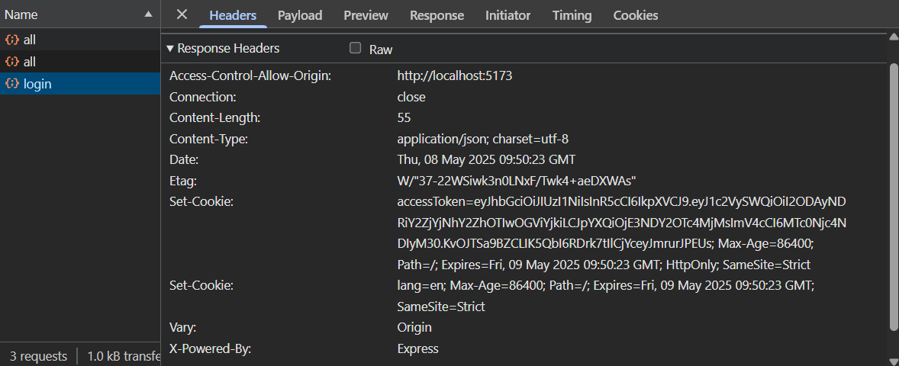
Cookies sent by backend server when the login api is hit:

Slide 10
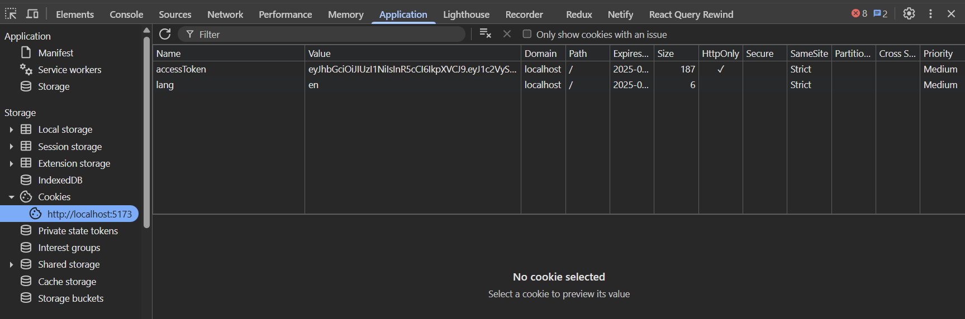
Cookies stored in browser:

Slide 11
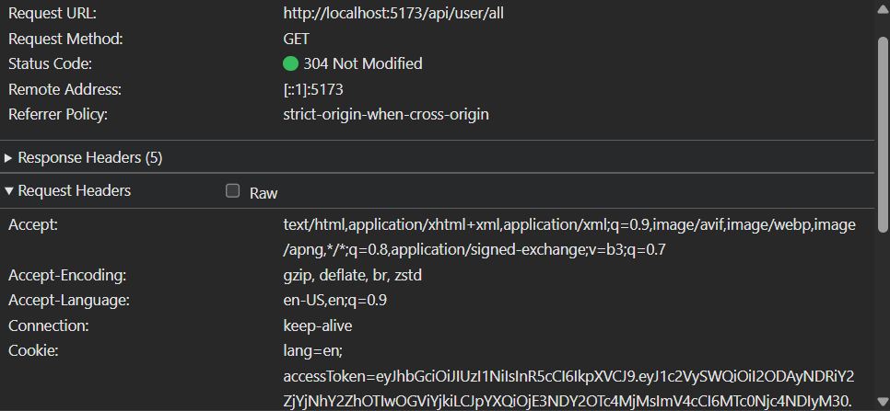
For all APIs that satisfy the path condition for the cookie, the browser will send back the cookies in the ‘Cookie’ header when those APIs are hit.

Slide 12
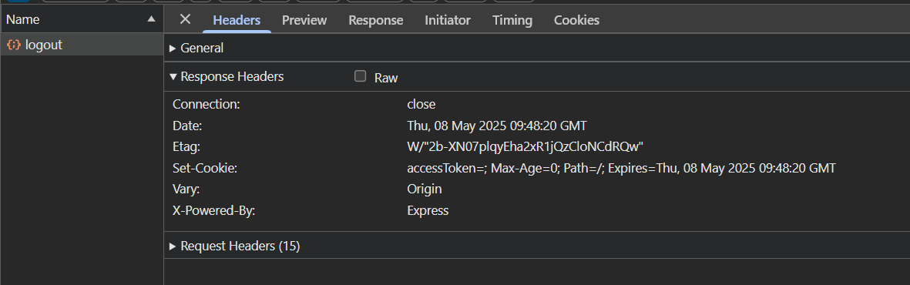
Delete authentication cookie on Logout
When the user clicks the log out button, hit an api /logout which will delete the cookie by setting the max-age to 0 (the value of cookie does not matter while deleting a cookie):

